Slide 1
VOYAGE
– the making of a HIT Anime
Under the guidance of
Dr. Dootika Vats
Presented By
GROUP 1

Slide 2
WHAT IS AN ANIME?

Slide 3

CINEMATOGRAPHY
GRAPHICS
CHARACTERISATION
ANIME
IDEAL STORYTELLING

Slide 4
PROBLEM STATEMENT

Slide 5

INDIAN BILLIONAIRE

Slide 6

DATA ANALYST

Slide 7


He wants to enter in ANIME INDUSTRY so takes help of a Data Analyst to suggest him some factors which can make an ANIME hit…..

Slide 8
DATA SOURCE
Data scraped from MyAnimeList : Popular site for Anime Ranking

Slide 9
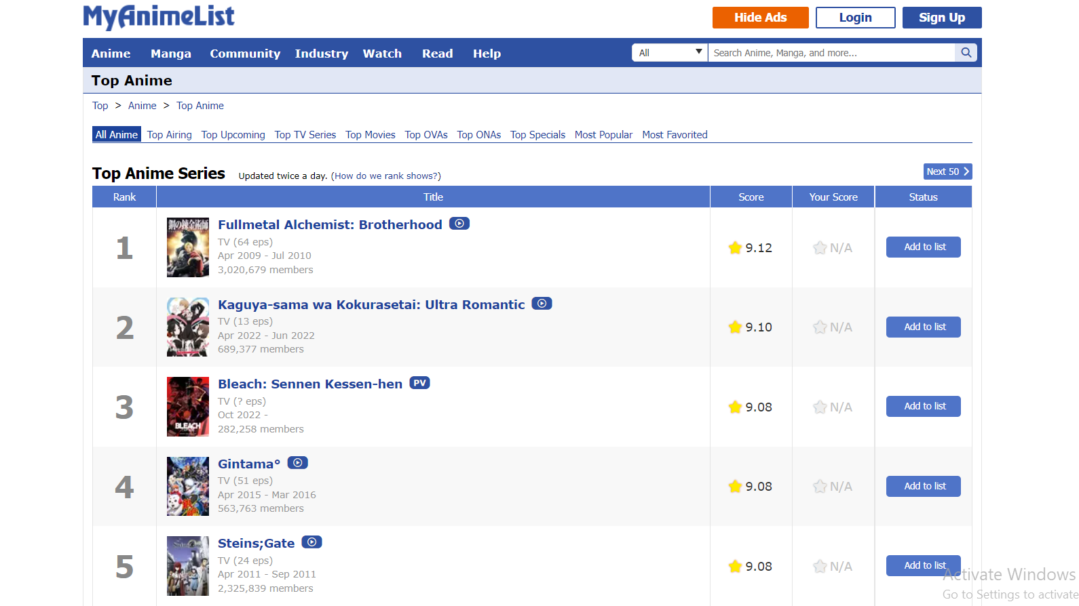

Slide 10
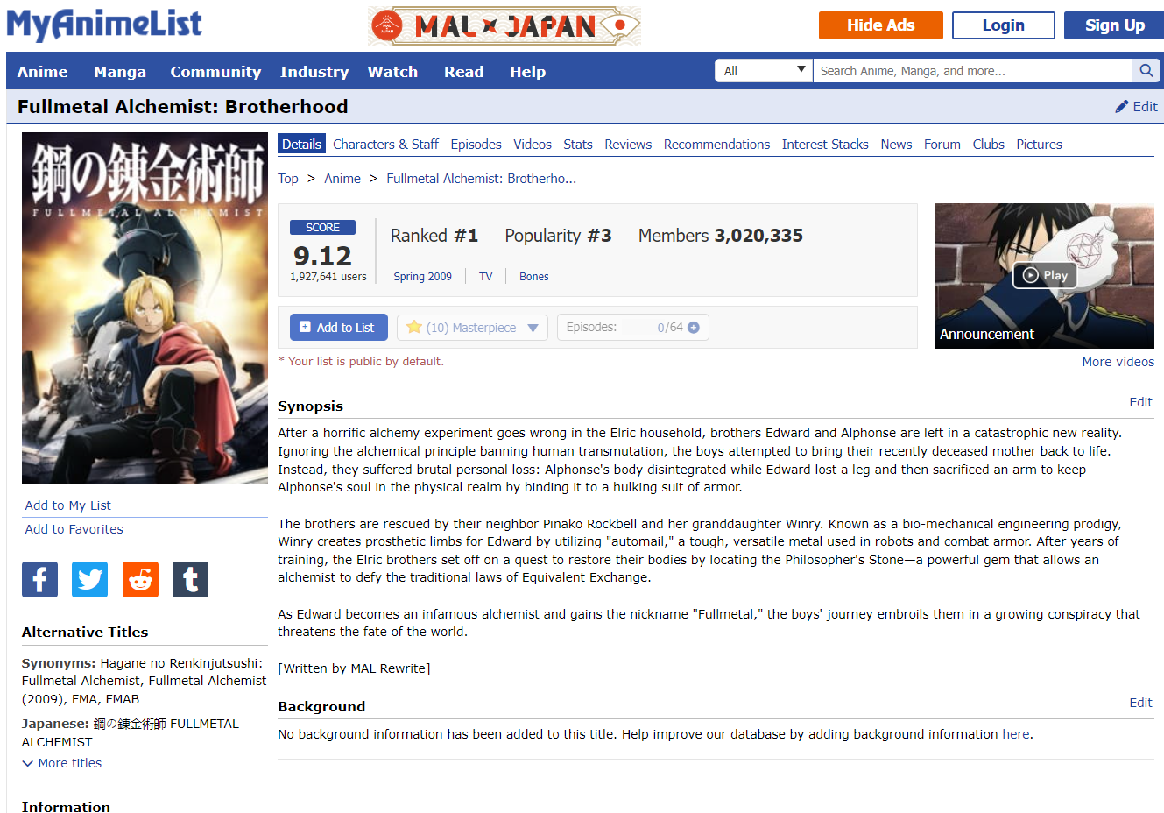
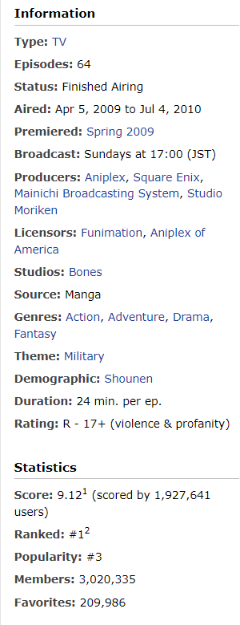

Slide 11
DATA DETAILS
FEATURES

Slide 12
VARIABLES
CATEGORICAL VARIABLES
NUMERICAL VARIABLES
Type
Status (of currently airing)
Aired (date and duration of airing)
Premiered (Season & Year)
Broadcast (Day of telecast)
Producers
Licensors
Studios
Source (Manga, Novel, original,..)
Genre (Mystery, Romance Action..)
Demography (Target audience)
Rating (Restricted, Parental Guidance, None)
Episodes (in number)
Duration (of 1 episode in min)
Score (out of 10)
Rank (Ranks acc. to score)
Popularity (Rank based on popularity)
Members (Users adding to their list)
Favorites (Users who liked that Anime)

Slide 13
VARIABLES
CATEGORICAL VARIABLES
NUMERICAL VARIABLES
Type
Status (of currently airing)
Aired (date and duration of airing)
Premiered (Season & Year)
Broadcast (Day of telecast)
Producers
Licensors
Studios
Source (Manga, Novel, original,..)
Genre (Mystery, Romance Action..)
Demography (Target audience)
Rating (Restricted, Parental Guidance, None)
Episodes (in number)
Duration (of 1 episode in min)
Score (out of 10)
Rank (Ranks acc. to score)
Popularity (Rank based on popularity)
Members (Users adding to their list)
Favorites (Users who liked that Anime)

Slide 14
DATA DETAILS
CHALLENGES

Slide 15
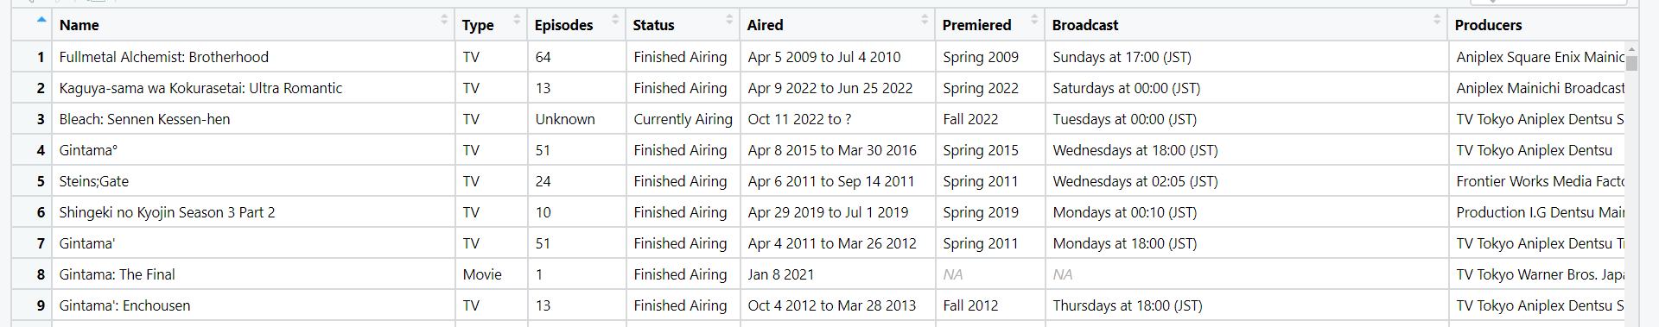
CHALLENGE 1 - Data Scraping
Data was not in table format
Entries did not follow any proper sequence inside a particular class, eg in spaceit_pad class for each anime there was a different sequence in which data was arranged.
SOLUTION
Used gsub and grepl function to build a function to extract data

Slide 16
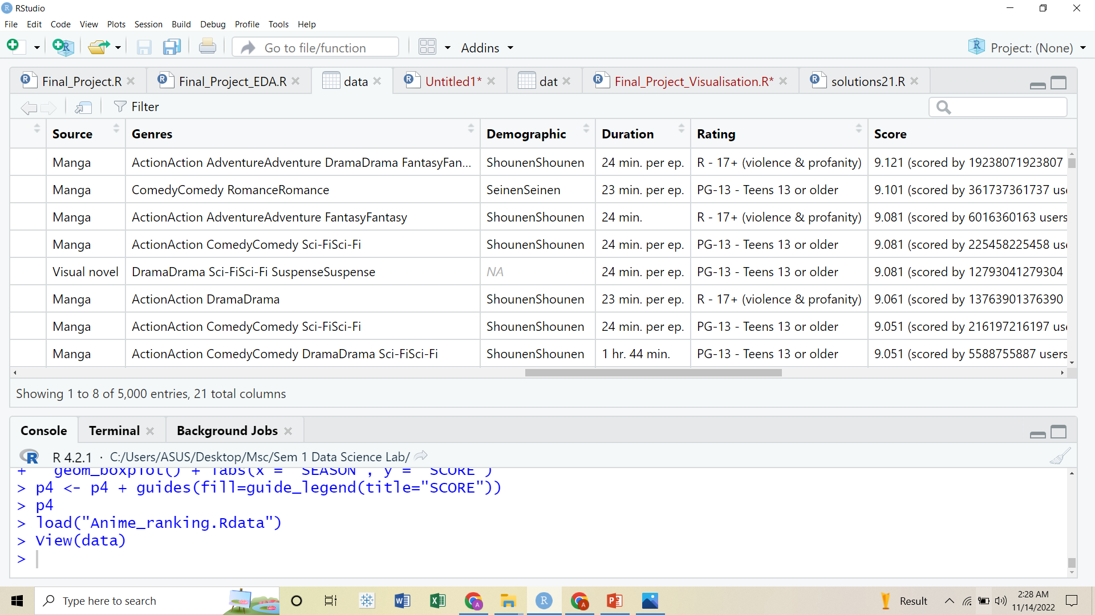
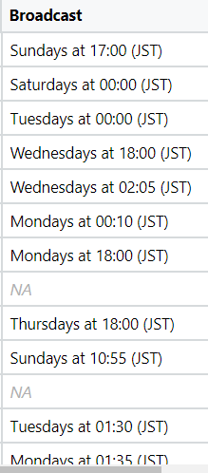
CHALLENGE 2 - Data Cleaning
Numeric data was having text which was not getting treated by substring , eg BROADCAST (day).
DURATION Column
GENRE column
SOLUTION
Used grepl function to build functions to extract data.

Slide 17
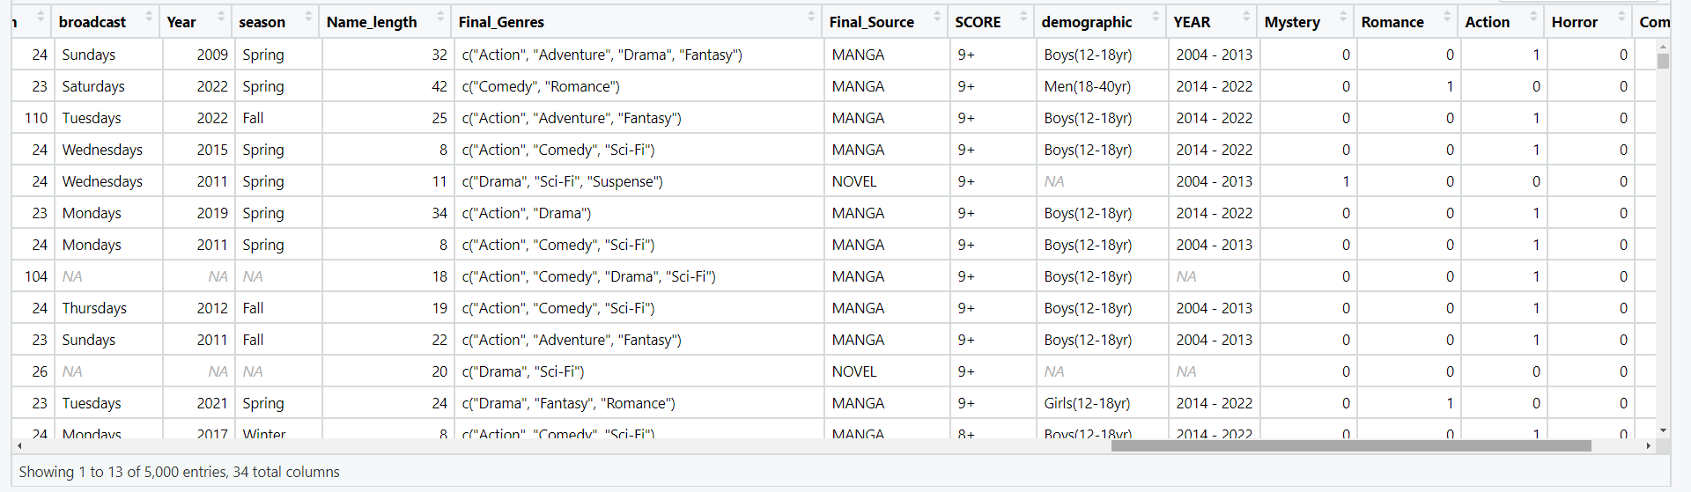

Slide 18
PLOTS
INFERENCE

Slide 19
SCORE increased when animes were targeted on Boys OF 12 TO 18 YEARS

Slide 20
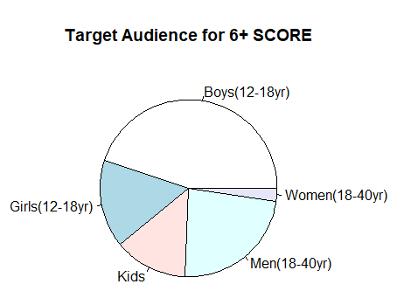
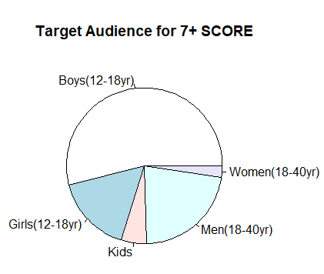
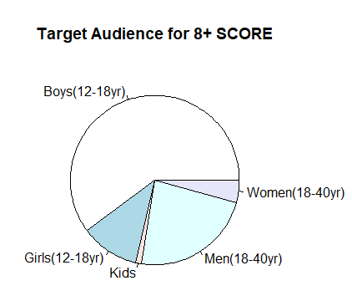
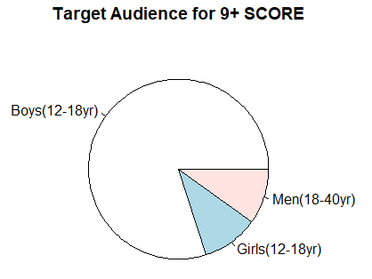

Slide 21
Animes targeted to Females had more
ROMANCE and COMEDY than for males,
whereas
for Males ACTION and MYSTERY had a good proportion.

Slide 22
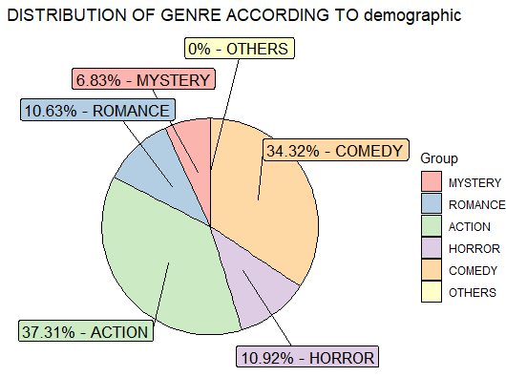
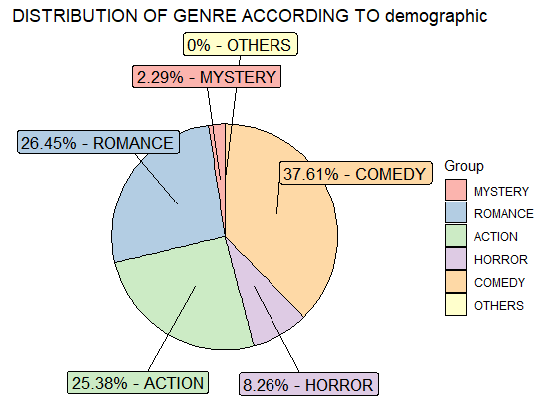
PIE CHART FOR MALES
PIE CHART FOR FEMALES

Slide 23

QUESTIONS IMPOSED…

Slide 24
Was there any impact of COVID on different aspects of anime (eg viewership)?

Slide 25
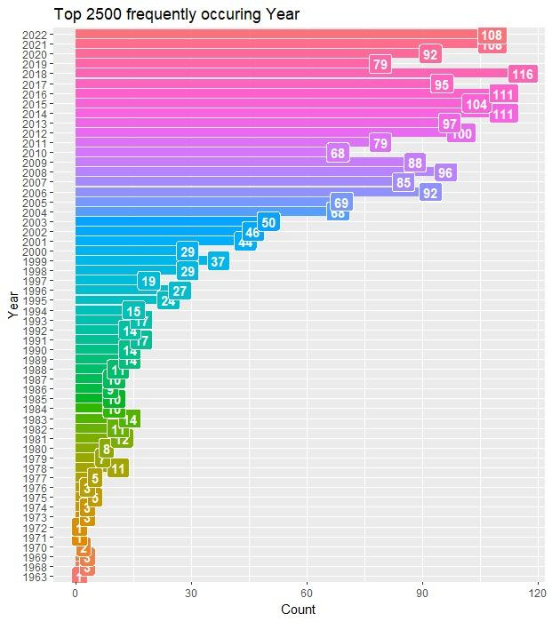

Slide 26
Does a studio house focus on “quality” or “quantity” in the process of making of animes?

Slide 27
What has more audience and viewership: “Movies” or “TV shows”?
Can we identify the Target Audience with maximum viewership?

Slide 28
Can a show be perfectly timed?
Premiering:
On a particular season?
On a particular month of the year?

Slide 29
Can a show be perfectly timed?
Broadcasting episodes:
During Weekends (Saturdays, Sundays)
Just before the weekends (Fridays)
Or during any other weekday

Slide 30
SHINY APP

Slide 31
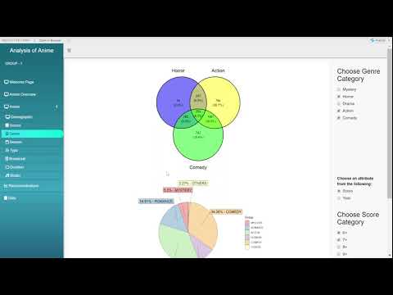

Slide 32

SOME INTERESTING INFERENCES

Slide 33
General expectations : Popular Anime Should have high Scores.
BUT
Popularity based Ranks and Score based ranks had Spearman Rank correlation 0.47 (Moderate Positive Correlation)

Slide 34
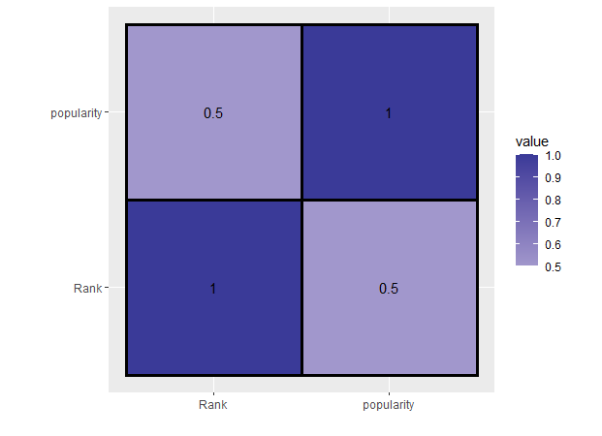
HEATMAP OF POPULARITY RANK AND SCORE RANK

Slide 35
New Animes are popular than Old.
Probable reasons
Lack of data of Animes before 1990 can give rise to bias in data.
Animation tools are much more advanced now than they were before 90s leading to more interactive visuals.

Slide 36
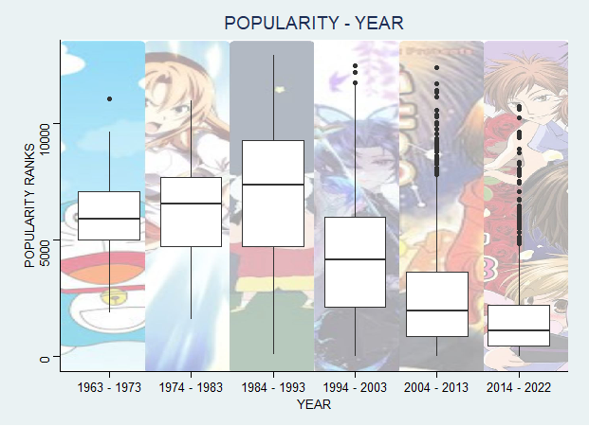
BIAS OF POPULARITY WITH RESPECT TO TIME

Slide 37
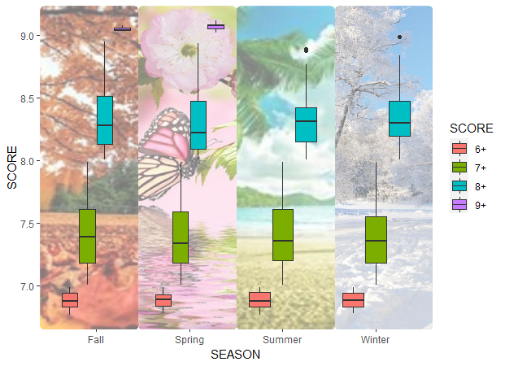
SEASON WISE ANALYSIS OF SCORE

Slide 38
CLAIM : Anime launched in Summer and Winter season had no 9+ SCORE
CLAIM STATUS: Not able to conclude
REASON: For the season column in the dataset we have more than 50% NA values, hence we cannot clearly claim this statement.

Slide 39
OBSERVATION
xy = c (hyperbolic), kind of curve between Duration and number of episodes.
Number of episodes increase when Duration decreases.

Slide 40
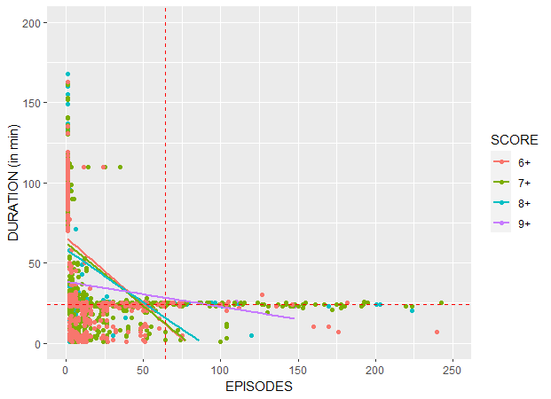

Slide 41
CONCLUSION

Slide 42
ANIME
GENRE
Comedy
Action
Mystery
Romance
TARGET
AUDIENCE
Boys(12 to 18 years)
POPULAR
SOURCE
Manga
STUDIOS
Toei Animation
Sunrise
TELECAST
TV
BROADCAST DAY
Sunday

Slide 43
THANK
YOU

